Slide 4
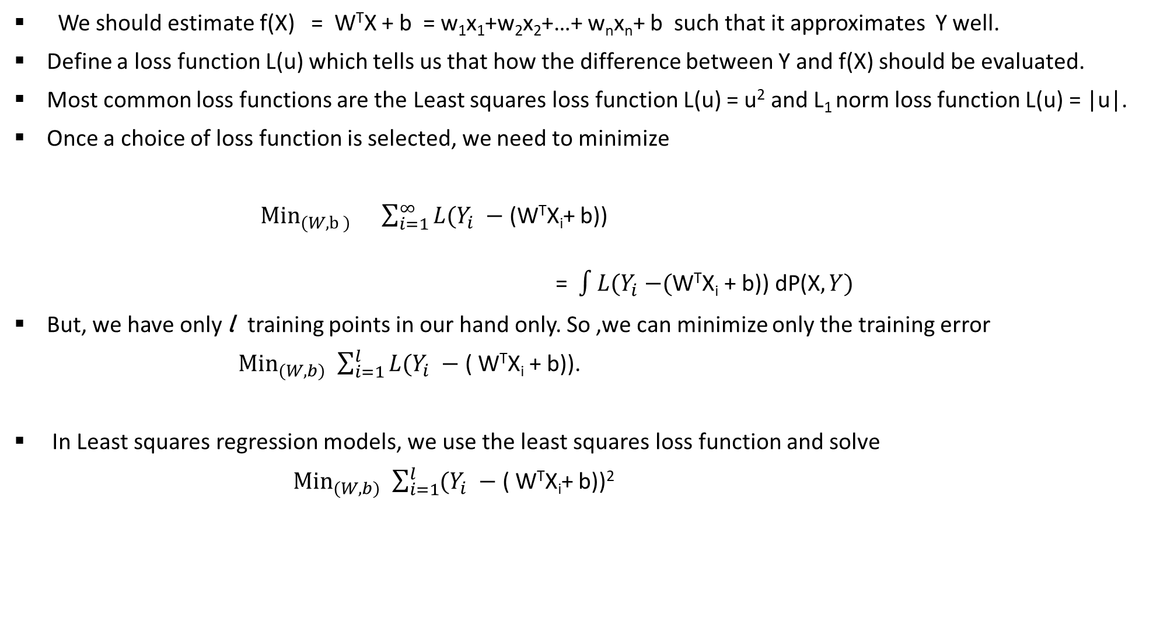
How to obtain parameters of linear regression model
We should estimate f(X) = W^{T}X + b = w₁x₁+w₂x₂+…+ w_{n}x_{n}+ b such that it approximates Y well.
Define a loss function L(u) which tells us that how the difference between Y and f(X) should be evaluated.
Most common loss functions are the Least squares loss function L(u) = u² and L₁ norm loss function L(u) = |u|.
Once a choice of loss function is selected, we need to minimize
${\text{Min}}_{(W,b ) } \sum_{i=1}^{∞}{L(Y_{i} − }$(W^{T}X_{i}+ b))
=$\int{L{(Y}_{i} −\text{(}\text{W}\text{T}\text{X}\text{i}\text{ + }\text{b}\text{)) }\text{dP}\text{(}\text{X}, Y)}$
But, we have only l training points in our hand only. So ,we can minimize only the training error
${\text{Min}}_{(W,b) }$ $\sum_{i=1}^{l}{L(Y_{i} − }$( W^{T}X_{i} + b)).
In Least squares regression models, we use the least squares loss function and solve
${\text{Min}}_{(W,b) }$ $\sum_{i=1}^{l}{(Y_{i} − }$( W^{T}X_{i}+ b))²

Slide 8

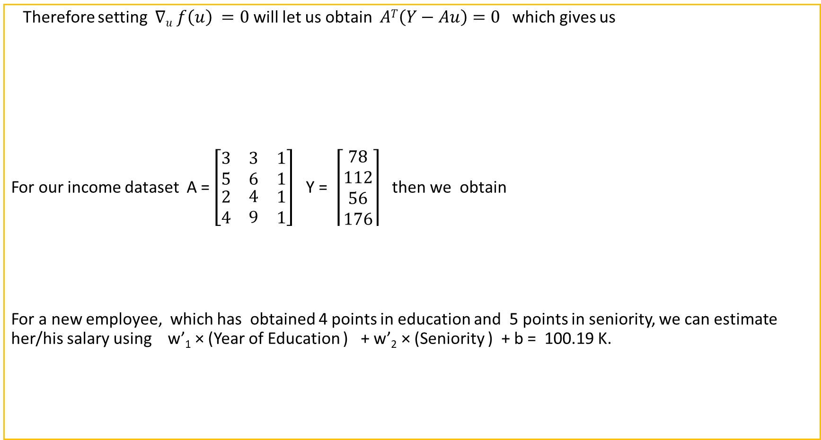

Back to our least squares regression problem
Therefore setting $∇u f\left(u\right) =0$ will let us obtain $AT\left(Y−Au\right)=0$ which gives us
For our income dataset A = $\left[\begin{matrix}3 & 3 & 1 \\ 5 & 6 & 1 \\ \begin{aligned}2 \\ 4\end{aligned} & \begin{aligned}4 \\ 9\end{aligned} & \begin{aligned}1 \\ 1\end{aligned}\end{matrix}\right]$ Y = $\left\lceil \begin{aligned}78 \\ 112 \\ 56 \\ 176\end{aligned}\right\rceil$ then we obtain
For a new employee, which has obtained 4 points in education and 5 points in seniority, we can estimate her/his salary using w’₁ × (Year of Education ) + w’₂ × (Seniority ) + b = 100.19 K.
u = $\left\lceil \begin{matrix}\begin{aligned}w1 \\ −\end{aligned} \\ \begin{aligned}− \\ wn\end{aligned} \\ b\end{matrix}\right\rceil$ = $\left(ATA\right)−1 ATY$
u = $\left\lceil \begin{aligned}w′1 \\ w′2 \\ b′\end{aligned}\right\rceil$ = $\left(ATA\right)−1 ATY =\left\lceil \begin{aligned}6.30 \\ 16.91 \\ −9.59\end{aligned}\right\rceil$

Slide 10
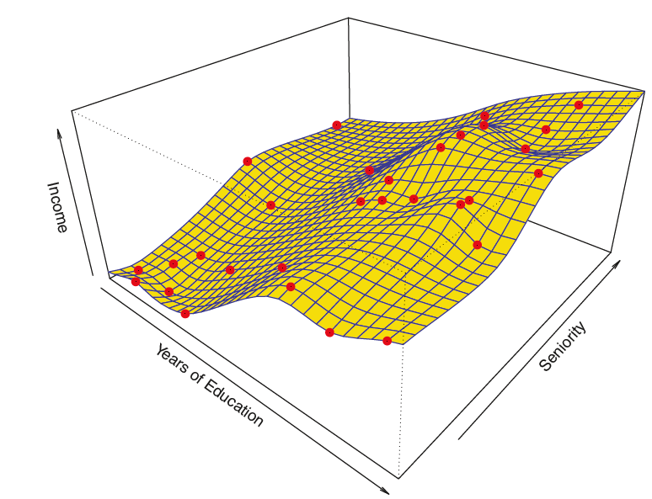
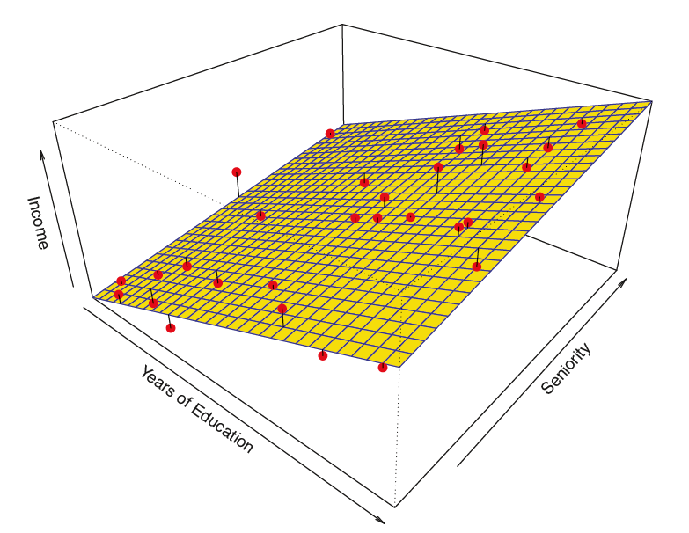

Least squares non-linear regression model
Linear Regression model
Non-linear Regression model

Slide 12



Least squares quadratic regression model
For the sake of simplicity, let us consider X = $\left[\begin{aligned}x1 \\ x2\end{aligned}\right].$
Then the quadratic function of X
f(X) = X^{T}CX + W^{T}X + b = $\left[x1, x2\right]\left[\begin{matrix}w11 & \frac{w12}{2} \\ \frac{w12}{2} & w22\end{matrix}\right] \left[\begin{matrix}x1 \\ x2\end{matrix}\right]$ + $\left[w1, w2\right]\left[\begin{matrix}x1 \\ x2\end{matrix}\right]$ + b = $w11x12+w12x22+w12x1x2+w1x1+w2x2+b$.
then the minimization of Least Square Loss function will let us obtain the problem
Min _{(b,w1,w2,w12,w11,w22)} $\sum_{i=1}^{l}{(Y−(w11xi12+w12xi22+w12xi1xi2+w1xi1+w2xi2+b\text{))}\text{2}\text{. }}$_{..(1)}
If we consider H = $\left[\begin{matrix}x112 & x122 & x12x11 \\ \begin{aligned}− \\ −\end{aligned} & \begin{aligned}− \\ −\end{aligned} & \begin{aligned}− \\ −\end{aligned} \\ xl12 & xl12 & xl2xl1\end{matrix}\begin{matrix} x11 & x12 & \begin{aligned} \\ 1\end{aligned} \\ \begin{aligned}− \\ −\end{aligned} & \begin{aligned}−\end{aligned} & \begin{aligned}− \\ .−\end{aligned} \\ xl1 & xl2 & 1\end{matrix}\right] and \text{u} \text{= }\left\lceil \begin{matrix}\begin{aligned}w11 \\ w22 \\ w12 \\ w1 \\ w2\end{aligned} \\ b\end{matrix}\right\rceil$ then the optimization problem (1) can be obtained as ${\text{Min}}_{(u) } f\left(u\right)=Min(u)\left(Y−Hu\right)T(Y−Hu)$ .
Setting $∇u f\left(u\right) =0 let us obtain$
u =$\left\lceil \begin{matrix}\begin{aligned}w11 \\ w22 \\ w12 \\ w1 \\ w2\end{aligned} \\ b\end{matrix}\right\rceil$= $\left(HTH\right)−1 HTY$

Slide 15
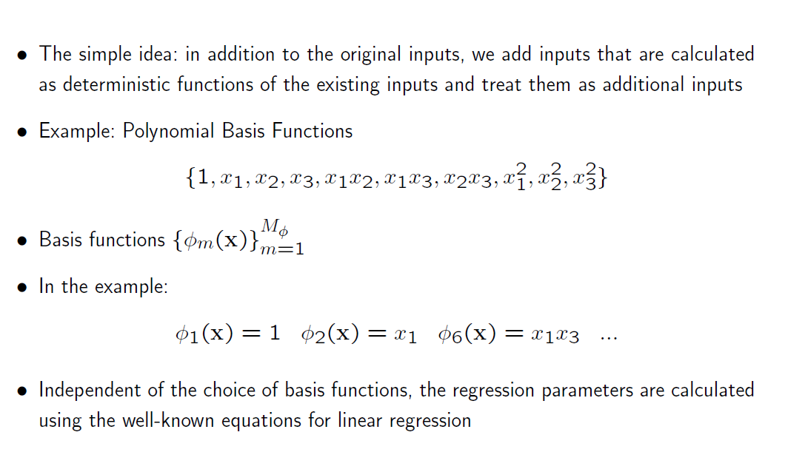

Slide 16
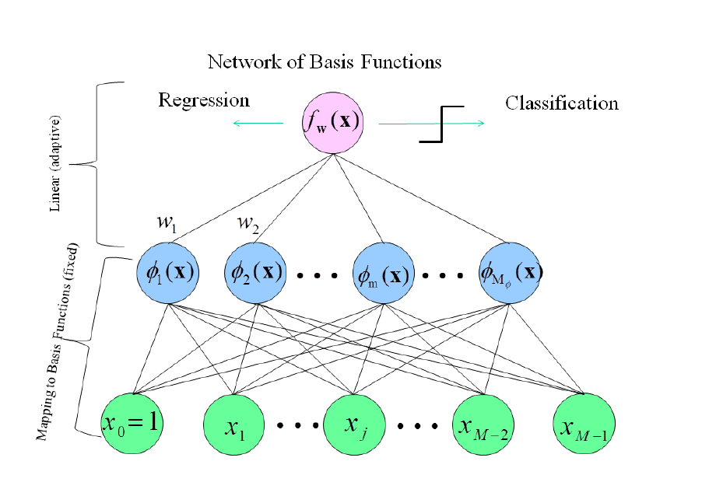

Slide 17
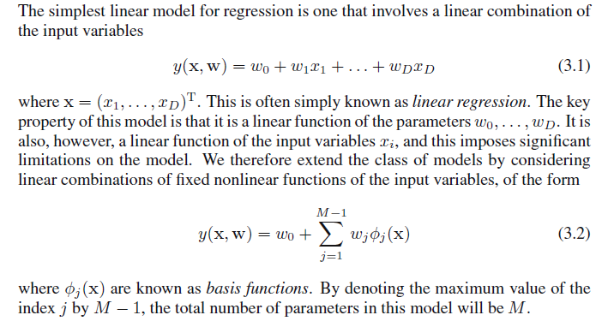

Slide 19

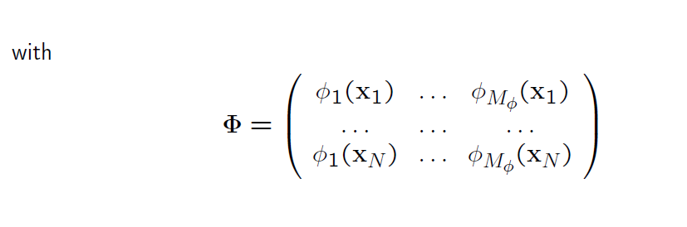

Slide 21
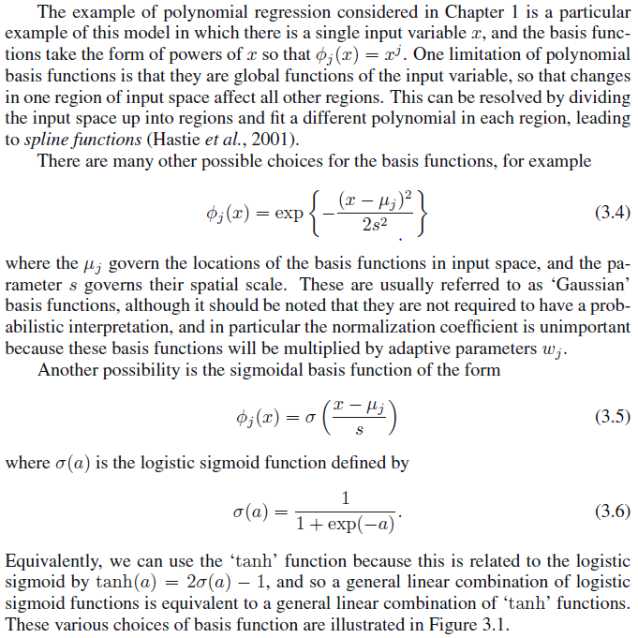

Slide 22
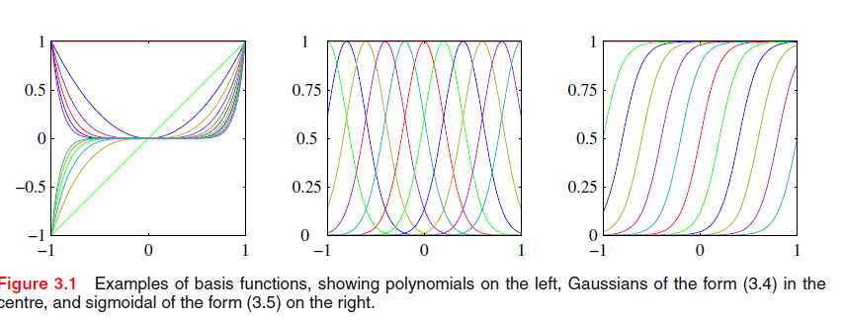

Slide 23
Generate 20 real number for the variable X from the uniform distribution U [0,1]
Construct the training set T = { (x₁,y₁),(x₂,y₂),……,(x₂₀,y₂₀)} using the relation
Yi = sin(2 π x_{i}) + ϵ_{i} where ϵ_{i} ~ N(0,0.25)
In the similar way construct a testing set of size 50
I,e. Test = { (x’₁,y’₁),(x’₂,y’₂),……,(x’₅₀,y’₅₀)}
Estimate the Least Square polynomial regression model of order M= 1,2, 3, 9, using the training set T.
For example for M=1 , we need to estimate
F(x) = β₁x + β₀
For M = 2
F(x) = β₂x² + β₁x + β₀ .
List the value of coefficients of estimated polynomial regression models for each case.
Obtain the prediction on testing set and compute the RMSE for polynomial regression models for order M =1,2,3 and 9 .
Plot the estimate obtained by polynomial regression models for order M =1,2,3 and 9 for training set along with y_{1,} y_{2,} , y_{50.} . Also plot our actual mean estiamte E(Y/X) = sin(2 π x_{i}) .
Plot the estimate obtained by polynomial regression models for order M =1,2,3 and 9 for testing set along with y’_{1,} y’_{2,} , y’_{50.} . Also plot the sin(2 π x’_{i}) .
What happens when we increase the value of M. Note down your observations.
Also ,try to find the statistical reasons behind your observation.
Enjoy now.
Note:- Do not use any inbuilt functions of MATLAB.

